Slide 1
Consciousness, Drugs, Sleep & Dreams
Randall C. O’Reilly

Slide 2
What is Consciousness?
Searle: “Consciousness consists of inner, qualitative, subjective states and feelings or awareness”
Qualitativeness: “feels like something..”
Subjectivity: each person has their own, cannot be experienced outside of a being..
Unity: single unified experience at each moment: not disjointed grab-bag of uncoordinated stuff..

Slide 3
The “hard problem”
Chalmers: How does a physical system (the brain) produce this amazing thing we experience as consciousness?
In other words, can we come up with an objective understanding of subjective experience? qualia = “what it feels like”
vs. “easy” problems: ability of system to access its own internal states, report on them; ability to focus attention; deliberate control of behavior…

Slide 4
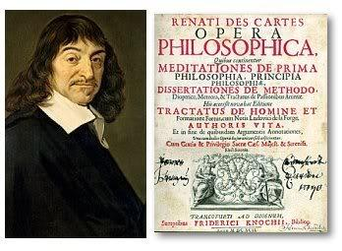
Descartes: Cogito Ergo Sum
I think, therefore I am
Subjective cognition is primary
Solipsism: subjective cognition is all there is!
Dualism: mind is separate from brain

Slide 5
Dueling Dualisms
Substance dualism: mind / soul vs. matter
- but how do they interact ever?
Perspective dualism: subjective vs. objective
- subjective is primary
- I believe in objective reality: my subjective experience makes sense in my understanding of objective reality (brain -> subjective experience)
- But no way to provide objective explanation in terms of neurons etc of “what it feels like”:
You have to be a brain to know what it feels like!

Slide 6
Consciousness = Human
Consciousness is just another name for what it’s subjectively like to “live” inside a human brain
Because we are human, consciousness = human
Nothing else has human consciousness, by definition.
BUT, animals share many brain features, and their subjective experience is likely to be similar in various ways.. But never the same.
No animal poets (yet) – literature = qualia..
And btw, I don’t even know about you..

Slide 7
Consciousness Science
Forget about all the philosophical mumbo-jumbo, and just do objective science on consciousness phenomenology:
When are people conscious, not, or altered?
What features / states of brain associated with different states of consciousness?
What features of subjective consciousness associate with different features of brain?
NCC: Neural Correlates of Consciousness

Slide 8
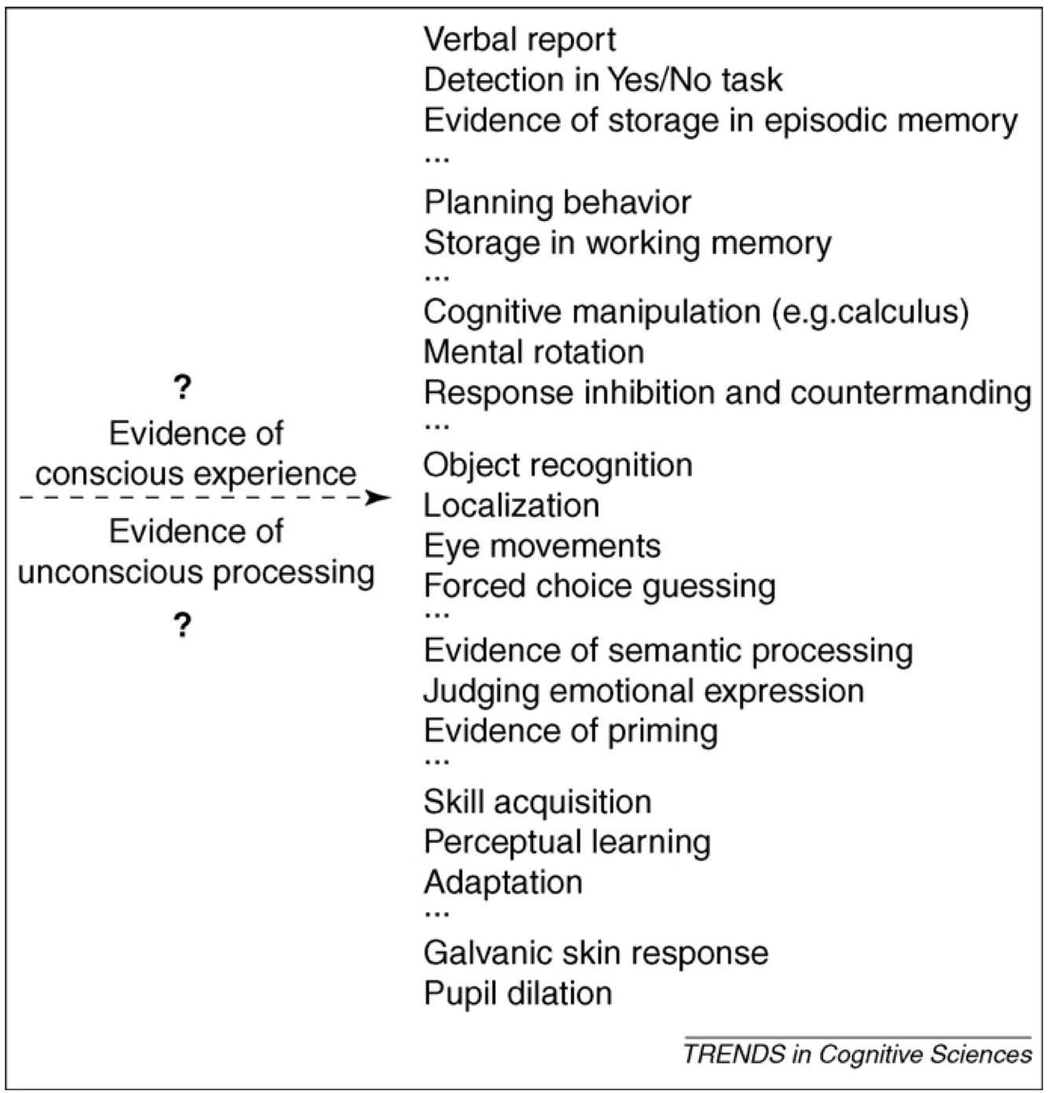
What Counts as Conscious?

Slide 9
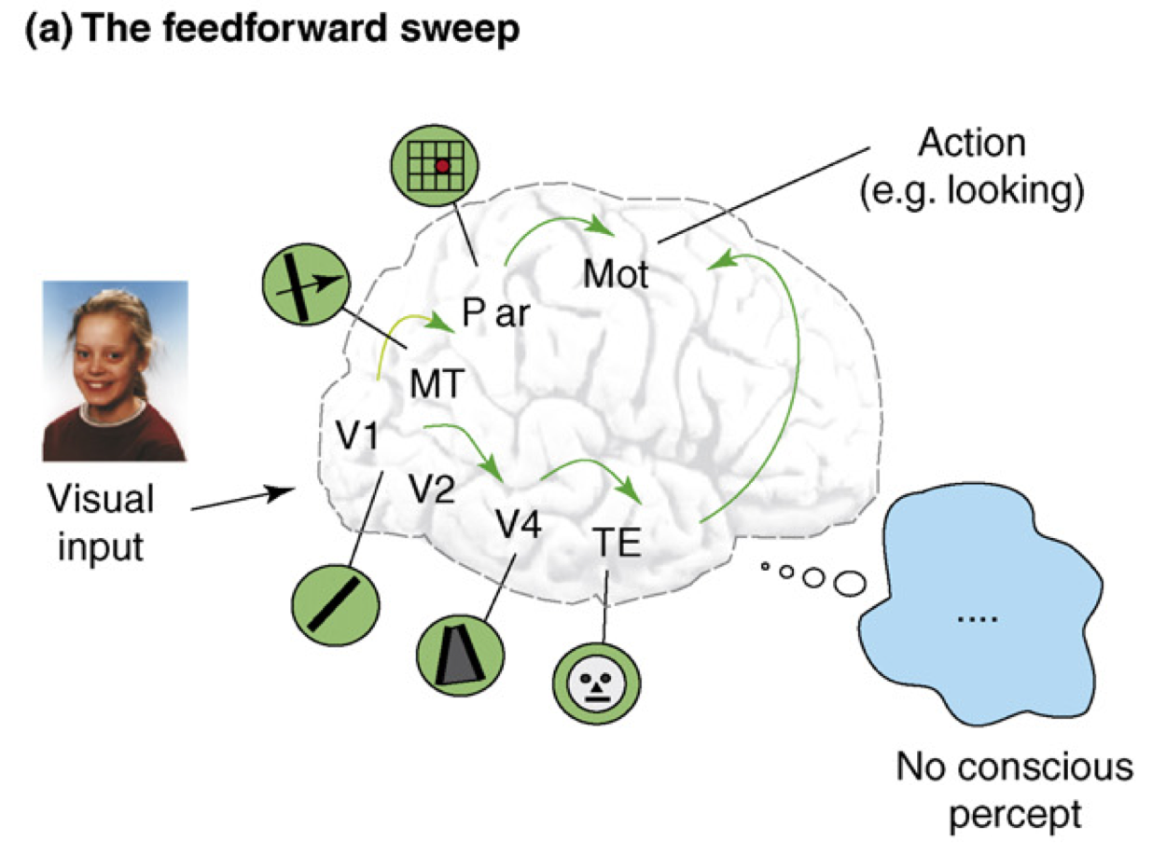
Recurrent Processing = Consciousness (Lamme, 2006)

Slide 10
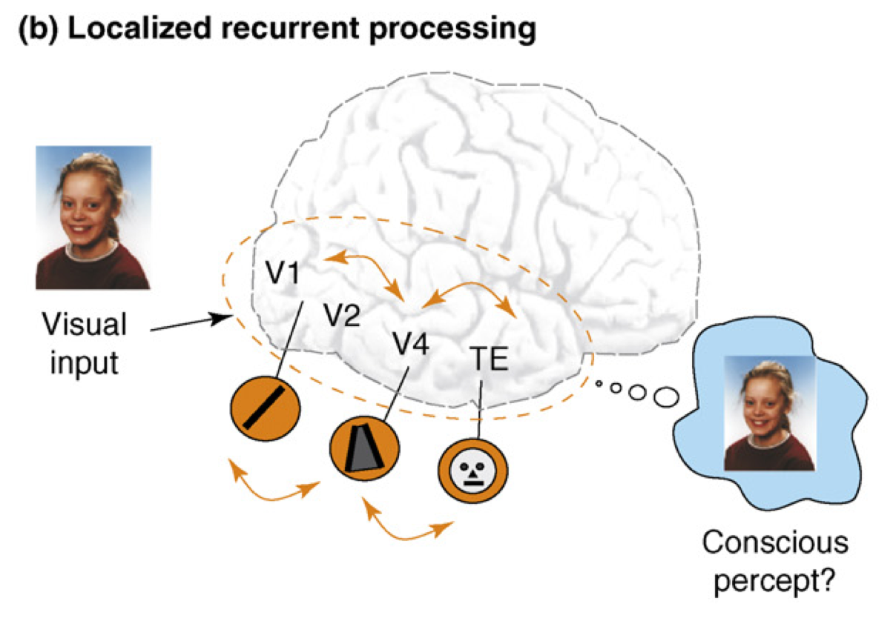
Recurrent Processing = Consciousness (Lamme, 2006)

Slide 11
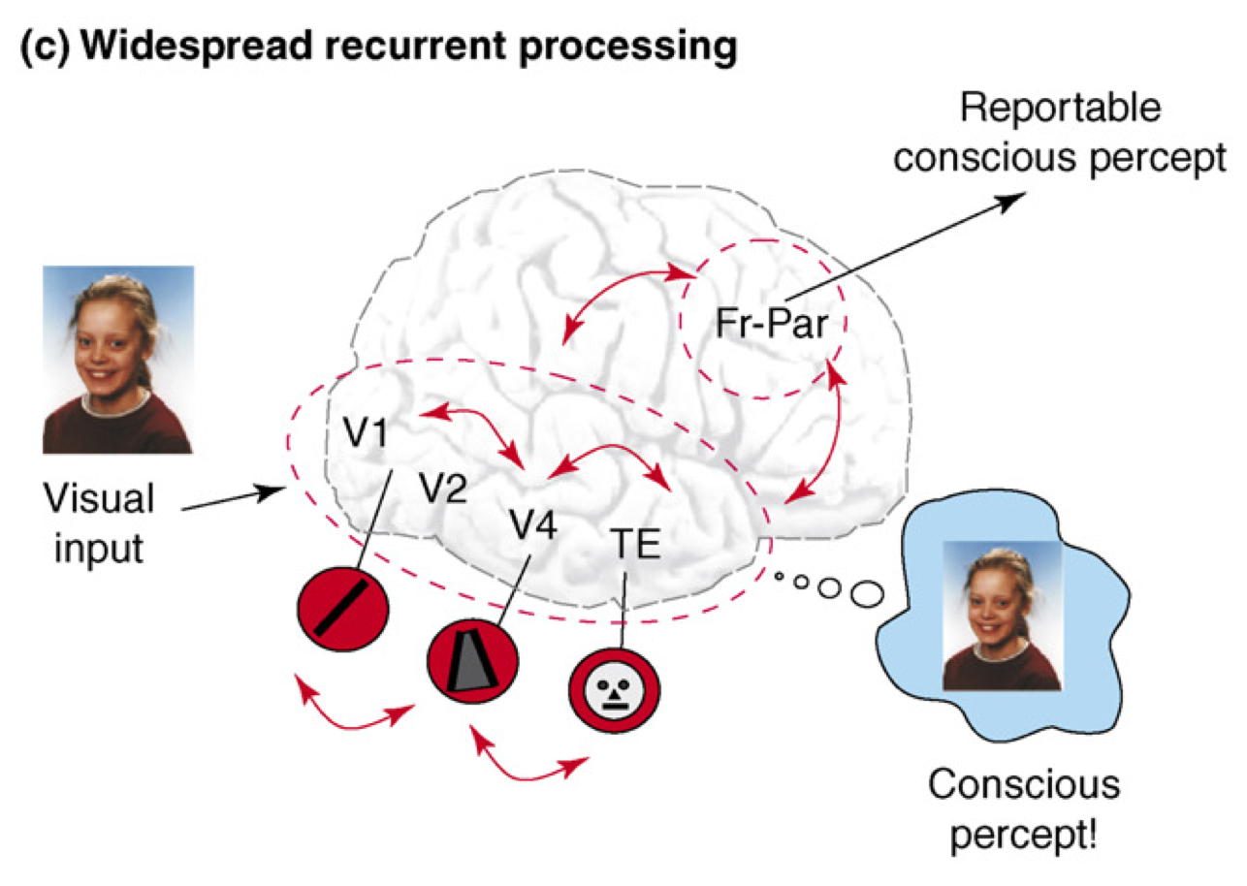
Recurrent Processing = Consciousness (Lamme, 2006)

Slide 12
Recurrence == Consciousness
Consciousness is Unitary
Recurrence coordinates all areas on one thing
(That thing emerges through popular vote)
Consciousness is Functional
We learn more about conscious things
It helps us organize, prioritize our behavior
“Focusing” is necessary for difficult problems

Slide 13
Is the Pulvinar the Silver Screen of the Cartesian Theater??
We have a compelling feeling that our conscious selves are watching a movie – pulvinar is kind of a movie screen where all of our predictions are projected, at V1 resolution.. hmm..
Global workspace? Brain synchronizer?

Slide 14
Is Twitter Conscious?
Tononi attempted to provide a mathematical measure of consciousness: integrated information -- many physical systems could have high values, e.g., a bunch of logic gates.
Twitter is a big recurrent network of communicating entities, like a neural network – is it conscious?

Slide 15
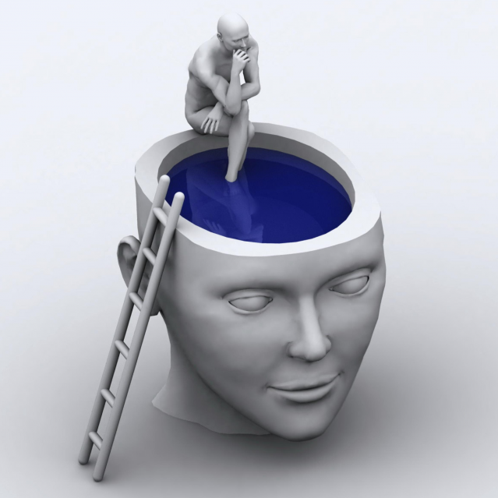
Metacognition
Awareness of awareness is also a key ingredient of human consciousness – likely associated with prefrontal cortex and other high-level brain areas.
Are you conscious when you’re not “mindful”?

Slide 16
Animal Consciousness?

Slide 17
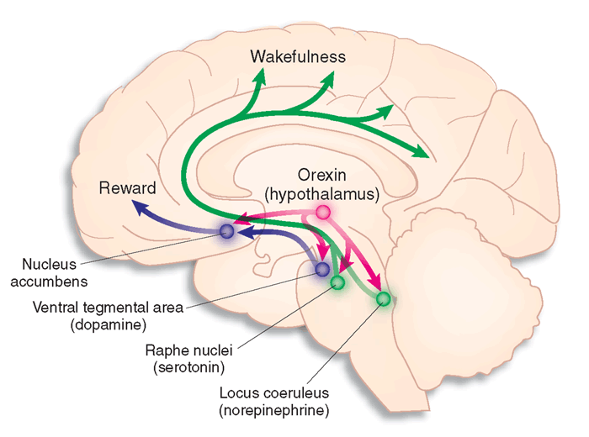
Altering Consciousness via Drugs
Drugs plug into native neurotransmitter pathways in the brain – provide a unique window into understanding how the brain works.
Reticular activating system:
VTA, SNc: Dopamine: learning
Raphe: Serotonin: sleep mood
LC: Norepinephrine: effort
Basal forebrain: Ach: attention

Slide 18
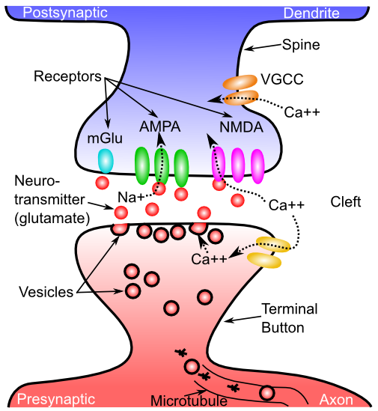
Neurotransmitters
Agonist: acts like a given neurotransmitter
Antagonist: blocks receptors for given NT
Reuptake: takes NT back out of synapse
Neuromodulator: a broadly-released neurotransmitter that has widespread modulatory effects on the brain

Slide 19
Neuromodulators and Drugs (receptor agonists)
Acetylcholine (ACh): muscles, attention, learning, memory (nicotine)
Dopamine (DA): when to learn, based on reward prediction errors (cocaine)
Norephinephrine (NE): attention, engagement (speed)
Serotonin (5HT): Mood, sleep, appetite, sex, stress (SSRI, LSD = waking dream)
Oxytocin: social modulation, labor (pitocin)
Endorphins, Substance P: pain (heroin)
GABA: inhibition (benzo, valium, etc)

Slide 20
Drug Categories
Narcotics: Opium derivatives (heroin, morphine..): opioid receptor agonists
Depressants: Benzo, Valium: GABA inhibition agonists
Stimulants: nicotine (ACh receptor agonist), cocaine (Dopamine receptor agonist), amphetamine (Norepinephrine + receptor agonist), caffeine (Adenosine antagonist -> Dopamine agonist)
Psychedelics: LSD, peyote, mescaline, psilocybin: affect serotonin; Marijuana: cannabanoid receptors

Slide 21
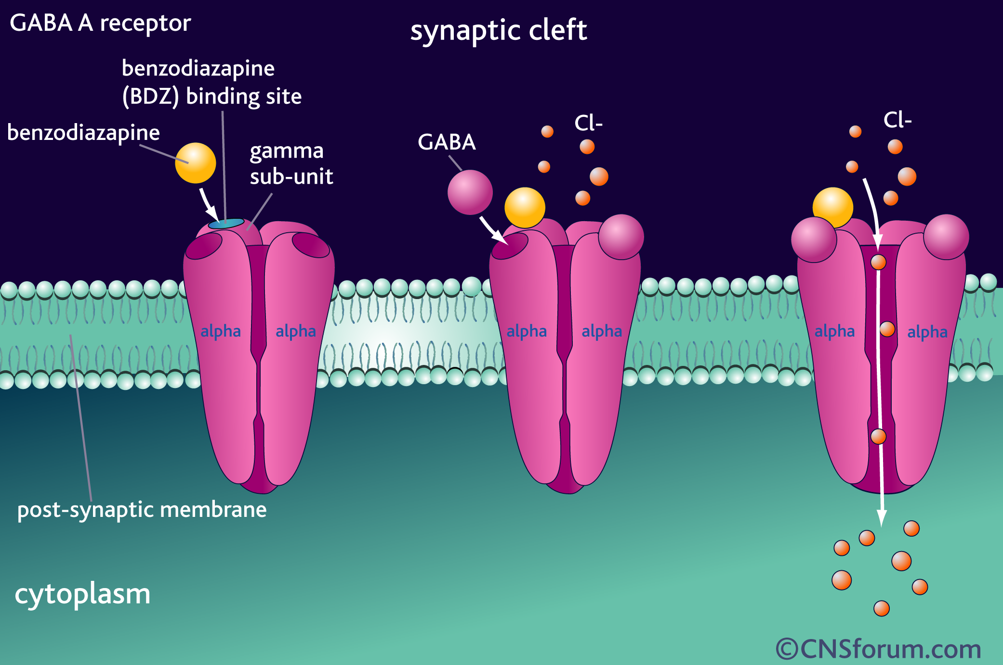
Benzo, Valium, etc
Agonist for GABA inhibitory channels

Slide 22
Mouse Party!
http://learn.genetics.utah.edu/content/addiction/mouse/

Slide 23
Addiction -> Dependence Terms
Withdrawal: unpleasant feelings from lack of use
Craving: overpowering feeling of wanting
Tolerance: progressive need for more to get same effect

Slide 24
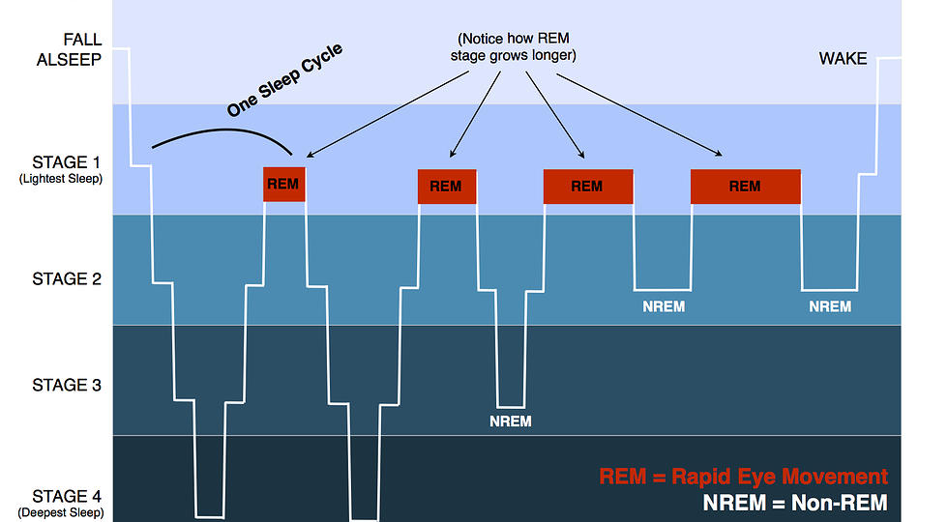
Sleep and Dreaming
Deeper = slower frequency brain waves (Theta -> Delta)
REM & Awake = Beta, Alpha, Theta

Slide 25
Why do we sleep?
Rebuild infrastructure: anabolic, protein synthesis
Catabolic = breaking down (during day)
Use brain during day, (re)build at night
Why babies sleep so much..
= better memory in am: “consolidated” synapses
- Sleep is key for health, immune function

Slide 26
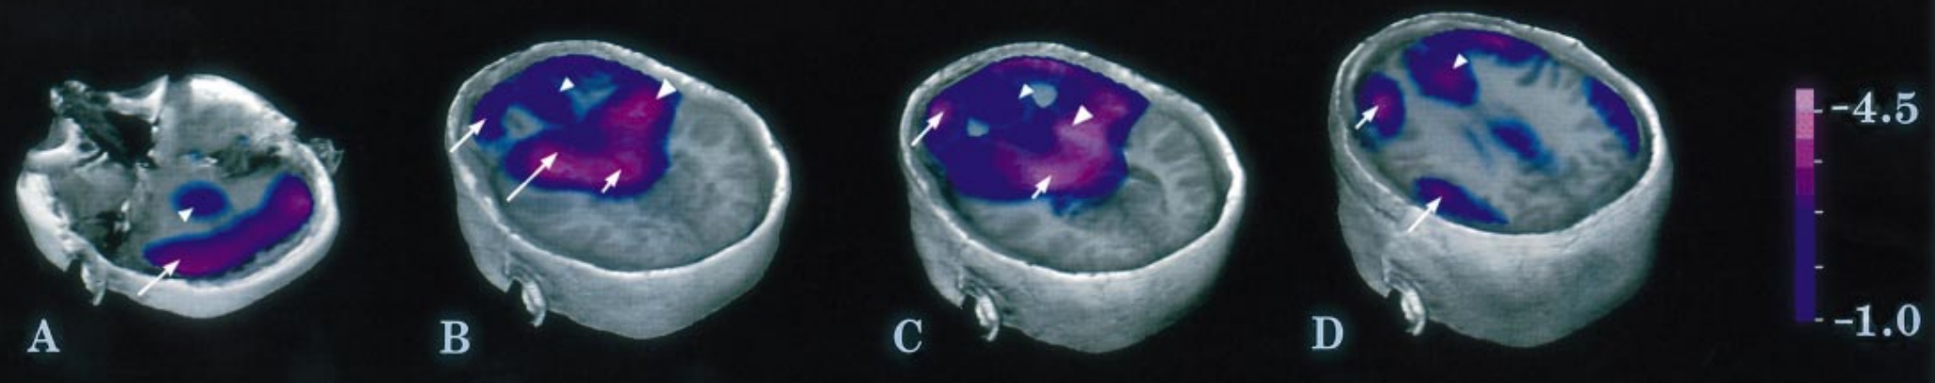
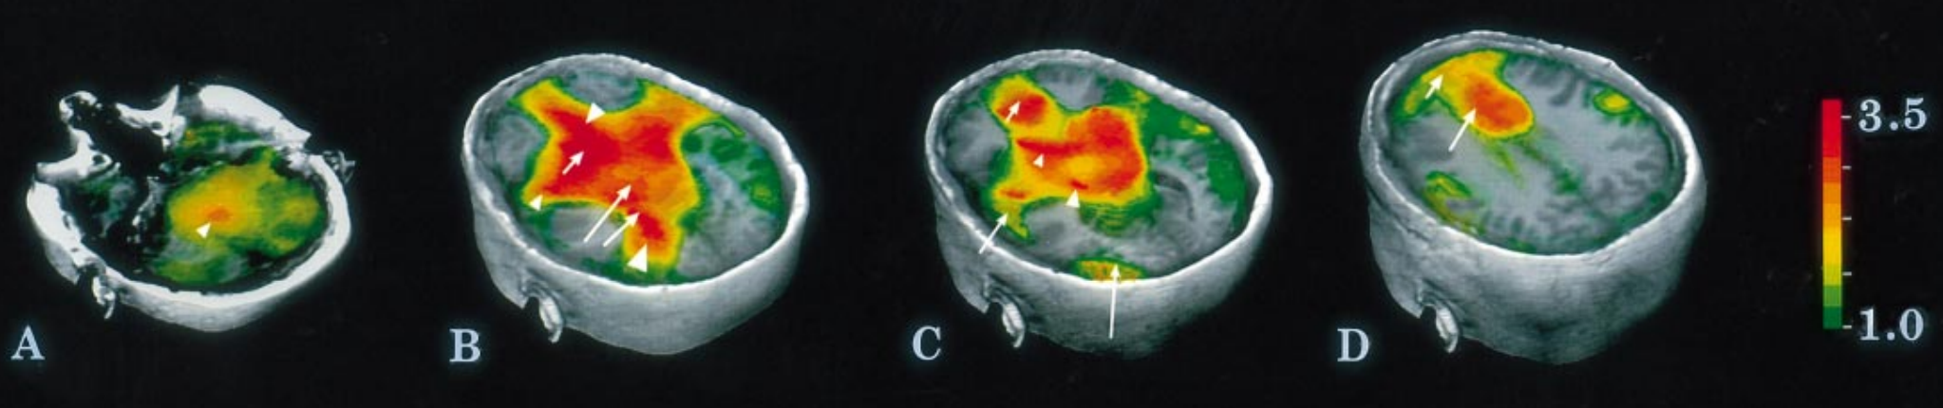
Your PFC Goes to Sleep
And your limbic system wakes up!
Dreams are disorganized, inconsistent over time
And very emotionally charged: lots of fear and lust..
Braun et al, 1997: http://brain.oxfordjournals.org/content/brain/120/7/1173.full.pdf

Slide 27
Why do we dream?
Epiphenomenon of random activity?
Replaying events of the day, to consolidate?
- Slow-Wave-Sleep: 50% dreaming
- REM: 80% dreaming – more vivid, memorable
Still don’t know if content of dreams matters..

Slide 28
Hypnosis
Unclear if a distinct state of consciousness, or just a combination of relaxed state, social suggestibility and role playing.
Bottom line: people are lemmings!

